Slide 1
Murach’s ASP.NET Core MVC (2nd Ed.)
Chapter 16
How to authenticate and authorize users

Slide 2
Objectives (part 1)
Applied
Restrict access to some or all pages of a web app.
Allow users who have registered and logged in to access the restricted pages that they are authorized to access.
Knowledge
Distinguish between authentication and authorization.
Describe how individual user account authentication works.
Describe how to use authorization attributes to restrict access to controllers and actions.
List and describe three properties of the IdentityUser class.
Describe how to add the Identity tables to the DB context class and the database.

Slide 3
Objectives (part 2)
Describe how to add the Identity service to the HTTP request and response pipeline, including how to configure password options.
Describe how to inject a SignInManager<T> object into a layout and use it to add Log In/Out buttons depending on whether the user is currently logged in.
Describe how to inject the UserManager<T>, SignInManager<T>, and RoleManager<T> objects into a controller.
Describe how to use the UserManager<T> class to create, update, and delete users.
Describe how to use the SignInManager<T> class to log users in and out.
Define roles and describe how they are used for authorization.
Describe how to use the RoleManager<T> and UserManager<T> classes to work with roles.

Slide 4
Windows-based authentication
Causes the browser to display a login dialog when the user attempts to access a restricted page.
Is supported by most browsers.
Is configured through the IIS management console.
Uses Windows user accounts and directory rights to grant access to restricted pages.
Is most appropriate for an intranet app.

Slide 5
Individual user account authentication
Allows developers to code a login page that gets the username and password.
Encrypts the username and password entered by the user if the login page uses a secure connection.
Doesn’t rely on Windows user accounts.

Slide 6
Third-party authentication services
Is provided by third parties such as Google, Facebook, Twitter, and Microsoft using technologies like OpenID and OAuth.
Allows users to use their existing logins and frees developers from having to worry about the secure storage of user credentials.
Can issue identities or accept identities from other web apps and access user data on other services.

Slide 7
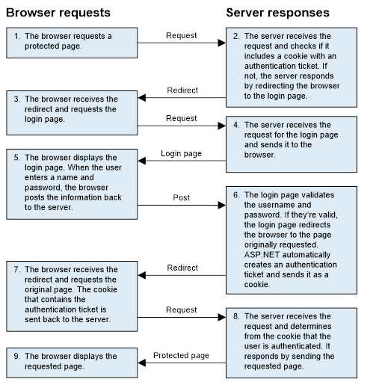
HTTP requests and responses

Slide 8
Some classes provided by ASP.NET Identity
IdentityDbContext
IdentityUser
IdentityRole
UserManager
RoleManager
SignInManager
IdentityResult

Slide 9
Some benefits of Identity
It can be used with all ASP.NET frameworks.
You have control over the schema of the data store that holds user information, and you can change the storage system from the default of SQL Server.
It’s modular, so it’s easier to unit test.
It supports claims-based authentication, which can be more flexible than using simple roles.
It supports third-party authentication providers.
It’s based on OWIN (Open Web Interface for .NET) middleware.
The classes that you need to work with it from code are available from ASP.NET Core.

Slide 10
Attributes for authorization
AllowAnonymous
Authorize
Authorize(Roles = "r1, r2")
The using directive for the Authorization namespace
using Microsoft.AspNetCore.Authorization;

Slide 11
Only allow logged in users to access an entire controller
[Authorize]
public class CartController : Controller {
...
}
Only allow logged in users in the Admin role to access an entire controller
[Authorize(Roles = "Admin")]
public class BookController : Controller {
...
}

Slide 12
Different attributes for different action methods
public class ProductController : Controller
{
...
[AllowAnonymous]
[HttpGet]
public IActionResult List() {
...
}
[Authorize]
[HttpGet]
public IActionResult Add()
{
...
}
[Authorize(Roles = "Admin")]
[HttpGet]
public IActionResult Delete(int id)
{
...
}
...
}

Slide 13
Some properties of the IdentityUser class
UserName
Password
ConfirmPassword
Email
EmailConfirmed
PhoneNumber
PhoneNumberConfirmed
The using directive for the ASP.NET Core Identity namespace
using Microsoft.AspNetCore.Identity

Slide 14
The User entity class
using Microsoft.AspNetCore.Identity;
namespace Bookstore.Models
{
public class User : IdentityUser {
// Inherits all IdentityUser properties
}
}

Slide 15
The NuGet package for Identity with EF Core
Microsoft.AspNetCore.Identity.EntityFrameworkCore

Slide 16
The Bookstore context class (part 1)
using Microsoft.EntityFrameworkCore;
using Microsoft.AspNetCore.Identity.EntityFrameworkCore;
namespace Bookstore.Models
{
public class BookstoreContext : IdentityDbContext<User>
{
public BookstoreContext(
DbContextOptions<BookstoreContext> options)
: base(options) { }
public DbSet<Author> Authors { get; set; } = null!;
public DbSet<Book> Books { get; set; } = null!;
public DbSet<Genre> Genres { get; set; } = null!;

Slide 17
The Bookstore context class (part 2)
protected override void OnModelCreating(
ModelBuilder modelBuilder)
{
base.OnModelCreating(modelBuilder);
// configure entities
modelBuilder.ApplyConfiguration(new ConfigureGenres());
modelBuilder.ApplyConfiguration(new ConfigureBooks());
modelBuilder.ApplyConfiguration(new ConfigureAuthors());
modelBuilder.ApplyConfiguration(
new ConfigureBookAuthors());
}
}
}

Slide 18
How to add Identity tables to the database
Start the Package Manager Console (PMC).
Add a migration that adds the tables by entering a command like this one:
Add-Migration AddIdentityTables
3. Update the database by entering a command like this one:
Update-Database

Slide 19
The Up() method of the generated migration class (part 1)
protected override void Up(MigrationBuilder migrationBuilder)
{
migrationBuilder.CreateTable(
name: "AspNetRoles",
columns: table => new {
Id = table.Column<string>(type: "nvarchar(450)", nullable: false),
Name = table.Column<string>(type: "nvarchar(256)", maxLength: 256,
nullable: true),
NormalizedName = table.Column<string>(type: "nvarchar(256)",
maxLength: 256, nullable: true),
ConcurrencyStamp = table.Column<string>(type: "nvarchar(max)",
nullable: true) },
constraints: table => {
table.PrimaryKey("PK_AspNetRoles", x => x.Id);
});

Slide 20
The Up() method of the generated migration class (part 2)
migrationBuilder.CreateTable(
name: "AspNetUsers",
columns: table => new {
Id = table.Column<string>(type: "nvarchar(450)", nullable: false),
UserName = table.Column<string>(type: "nvarchar(256)", maxLength:
256, nullable: true),
NormalizedUserName = table.Column<string>(type: "nvarchar(256)",
maxLength: 256, nullable: true),
Email = table.Column<string>(type: "nvarchar(256)", maxLength: 256,
nullable: true),
NormalizedEmail = table.Column<string>(type: "nvarchar(256)",
maxLength: 256, nullable: true),
EmailConfirmed = table.Column<bool>(type: "bit", nullable: false),
PasswordHash = table.Column<string>(type: "nvarchar(max)",
nullable: true),
SecurityStamp = table.Column<string>(type: "nvarchar(max)",
nullable: true),
ConcurrencyStamp = table.Column<string>(type: "nvarchar(max)",
nullable: true),
PhoneNumber = table.Column<string>(type: "nvarchar(max)",
nullable: true),
PhoneNumberConfirmed = table.Column<bool>(type: "bit",
nullable: false),
TwoFactorEnabled = table.Column<bool>(type: "bit",
nullable: false),

Slide 21
The Up() method of the generated migration class (part 3)
LockoutEnd = table.Column<DateTimeOffset>(type: "datetimeoffset",
nullable: true),
LockoutEnabled = table.Column<bool>(type: "bit", nullable: false),
AccessFailedCount = table.Column<int>(type: "int",
nullable: false)},
constraints: table => {
table.PrimaryKey("PK_AspNetUsers", x => x.Id);
});
...

Slide 22
How to add the Identity service with default password options
...
var builder = WebApplication.CreateBuilder(args);
// other services
builder.Services.AddIdentity<User, IdentityRole>()
.AddEntityFrameworkStores<BookstoreContext>()
.AddDefaultTokenProviders();
...
The using directive for the Identity namespace
using Microsoft.AspNetCore.Identity;

Slide 23
Some properties of the PasswordOptions class
RequiredLength
RequireLowercase
RequireUppercase
RequireDigit
RequireNonAlphanumeric

Slide 24
How to set the password options
builder.Services.AddIdentity<User, IdentityRole>(
options => {
options.Password.RequiredLength = 6;
options.Password.RequireNonAlphanumeric = false;
options.Password.RequireDigit = false;
}).AddEntityFrameworkStores<BookstoreContext>()
.AddDefaultTokenProviders();

Slide 25
How to configure your app to use authentication and authorization
...
var app = builder.Build();
...
app.UseRouting();
app.UseAuthentication();
app.UseAuthorization();
app.UseSession();
...

Slide 26
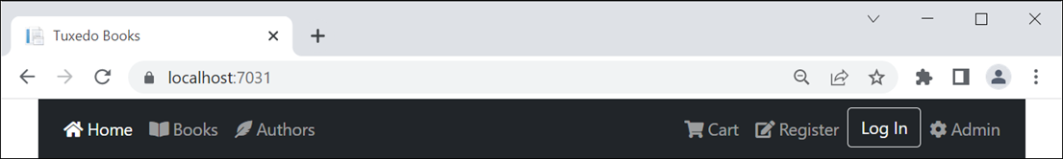
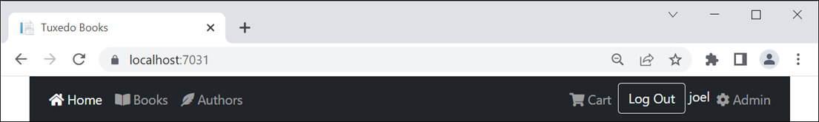
The Register link and the Log In button in the navbar
The Log Out button in the navbar

Slide 27
Some of the code for the navbar (part 1)
<!-- Home, Books, Authors, and Cart links go here -->
@using Microsoft.AspNetCore.Identity
@inject SignInManager<User> signInManager
@if (signInManager.IsSignedIn(User))
{
// signed-in user - Log Out button and username
<li class="nav-item">
<form method="post" asp-action="Logout"
asp-controller="Account" asp-area="">
<input type="submit" value="Log Out"
class="btn btn-outline-light" />
<span class="text-light">@User.Identity.Name</span>
</form>
</li>
}

Slide 28
Some of the code for the navbar (part 2)
else
{
// get current action
var action = ViewContext.RouteData.Values["action"]?.ToString();
// anonymous user - Register link and Log In button
<li class="nav-item @Nav.Active("Register", action)">
<a asp-action="Register" asp-controller="Account"
asp-area="" class="nav-link">
<span class="fas fa-edit"></span>&nbsp;Register</a>
</li>
<li class="nav-item">
<a asp-action="Login" asp-controller="Account" asp-area=""
class="btn btn-outline-light">Log In</a>
</li>
}
<!-- Admin link goes here -->

Slide 29
Some starting code for the Account controller
using Microsoft.AspNetCore.Mvc;
using Microsoft.AspNetCore.Identity;
using Bookstore.Models;
namespace Bookstore.Controllers
{
public class AccountController : Controller
{
private UserManager<User> userManager;
private SignInManager<User> signInManager;
public AccountController(UserManager<User> userMngr,
SignInManager<User> signInMngr)
{
userManager = userMngr;
signInManager = signInMngr;
}
// The Register(), LogIn(), and LogOut()methods go here
}
}

Slide 30
The URL that MVC redirects to for an unauthenticated request
/account/login

Slide 31
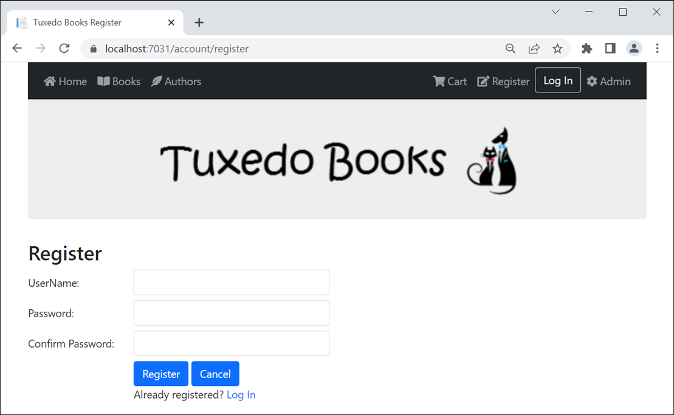
The Register page

Slide 32
The Register view model
using System.ComponentModel.DataAnnotations;
namespace Bookstore.Models
{
public class RegisterViewModel
{
[Required(ErrorMessage = "Please enter a username.")]
[StringLength(255)]
public string Username { get; set; } = string.Empty;
[Required(ErrorMessage = "Please enter a password.")]
[DataType(DataType.Password)]
[Compare("ConfirmPassword")]
public string Password { get; set; } = string.Empty;
[Required(ErrorMessage = "Please confirm your password.")]
[DataType(DataType.Password)]
[Display(Name = "Confirm Password")]
public string ConfirmPassword { get; set; } = string.Empty;
}
}

Slide 33
The Register() action method for GET requests
[HttpGet]
public IActionResult Register()
{
return View();
}

Slide 34
The Account/Register view (part 1)
@model RegisterViewModel
@{
ViewBag.Title = "Register";
}
<h2>Register</h2>
<div asp-validation-summary="ModelOnly" class="text-danger"></div>
<form method="post" asp-action="Register">
<div class="row mb-2">
<label class="col-form-label col-md-2">UserName:</label>
<div class="col-md-4">
<input asp-for="Username" class="form-control" />
</div>
<div class="col">
<span asp-validation-for="Username"
class="text-danger"></span>
</div>
</div>

Slide 35
The Account/Register view (part 2)
<div class="row mb-2">
<label class="col-form-label col-md-2">Password:</label>
<div class="col-md-4">
<input type="password" asp-for="Password"
class="form-control" />
</div>
<div class="col">
<span asp-validation-for="Password"
class="text-danger"></span>
</div>
</div>
<div class="row mb-2">
<label class="col-form-label col-md-2">
Confirm Password:</label>
<div class="col-md-4">
<input type="password" asp-for="ConfirmPassword"
class="form-control" />
</div>
</div>

Slide 36
The Account/Register view (part 3)
<div class="row">
<div class="col offset-md-2">
<button type="submit" class="btn btn-primary">
Register</button>
<a asp-action="Index" asp-controller="Home"
class="btn btn-primary">Cancel</a>
</div>
</div>
<div class="row">
<div class="col offset-md-2">
Already registered? <a asp-action="LogIn">Log In</a>
</div>
</div>
</form>

Slide 37
Three methods of the UserManager class
CreateAsync(user)
UpdateAsync(user)
DeleteAsync(user)
Two methods of the SignInManager class
SignInAsync(user, isPersistent)
SignOutAsync()
Two properties of the IdentityResult class
Succeeded
Errors

Slide 38
The Register() action method for POST requests
[HttpPost]
public async Task<IActionResult> Register(
RegisterViewModel model) {
if (ModelState.IsValid) {
var user = new User { UserName = model.Username };
var result = await userManager.CreateAsync(user,
model.Password);
if (result.Succeeded) {
await signInManager.SignInAsync(user,
isPersistent: false);
return RedirectToAction("Index", "Home");
}
else {
foreach (var error in result.Errors) {
ModelState.AddModelError("", error.Description);
}
}
}
return View(model);
}

Slide 39
The LogOut() action method for POST requests
[HttpPost]
public async Task<IActionResult> LogOut() {
await signInManager.SignOutAsync();
return RedirectToAction("Index", "Home");
}

Slide 40
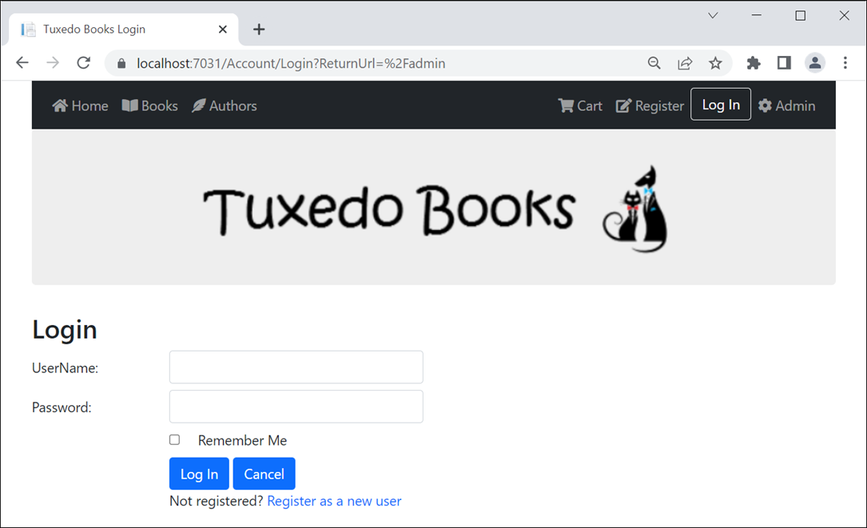
The Login page

Slide 41
The Login view model
using System.ComponentModel.DataAnnotations;
namespace Bookstore.Models
{
public class LoginViewModel
{
[Required(ErrorMessage = "Please enter a username.")]
[StringLength(255)]
public string Username { get; set; } = string.Empty;
[Required(ErrorMessage = "Please enter a password.")]
[StringLength(255)]
public string Password { get; set; } = string.Empty;
public string ReturnUrl { get; set; } = string.Empty;
public bool RememberMe { get; set; }
}
}

Slide 42
The LogIn() action method for GET requests
[HttpGet]
public IActionResult LogIn(string returnURL = "")
{
var model = new LoginViewModel { ReturnUrl = returnURL };
return View(model);
}

Slide 43
The Login view (part 1)
@model LoginViewModel
@{
ViewBag.Title = "Login";
}
<h2>Login</h2>
<div asp-validation-summary="ModelOnly" class="text-danger"></div>
<form method="post" asp-action="LogIn"
asp-route-returnUrl="@Model.ReturnUrl">
<div class="row mb-2">
<label class="col-form-label col-md-2">UserName:</label>
<div class="col-md-4">
<input asp-for="Username" class="form-control" />
</div>
<div class="col">
<span asp-validation-for="Username"
class="text-danger"></span>
</div>
</div>

Slide 44
The Login view (part 2)
<div class="row mb-2">
<label class="col-form-label col-md-2">Password:</label>
<div class="col-md-4">
<input type="password" asp-for="Password"
class="form-control" />
</div>
<div class="col">
<span asp-validation-for="Password"
class="text-danger"></span>
</div>
</div>
<div class="row mb-2">
<div class="col offset-md-2">
<input type="checkbox" title="Remember Me"
asp-for="RememberMe"
class="form-check-inline" />
<label>Remember Me</label>
</div>
</div>

Slide 45
The Login view (part 3)
<div class="row">
<div class="col offset-md-2">
<button type="submit" class="btn btn-primary">
Log In</button>
<a asp-action="Index" asp-controller="Home"
class="btn btn-primary">Cancel</a>
</div>
</div>
<div class="row">
<div class="col offset-md-2">
Not registered?
<a asp-action="Register">Register as a new user</a>
</div>
</div>
</form>

Slide 46
Another method of the SignInManager class
PasswordSignInAsync(username, password, isPersistent,
lockoutOnFailure)

Slide 47
The LogIn() action method for POST requests
[HttpPost]
public async Task<IActionResult> LogIn(LoginViewModel model)
{
if (ModelState.IsValid) {
var result = await signInManager.PasswordSignInAsync(
model.Username, model.Password,
isPersistent: model.RememberMe,
lockoutOnFailure: false);
if (result.Succeeded) {
if (!string.IsNullOrEmpty(model.ReturnUrl) &&
Url.IsLocalUrl(model.ReturnUrl))
{
return Redirect(model.ReturnUrl);
}
else
{
return RedirectToAction("Index", "Home");
}
}
}
ModelState.AddModelError("", "Invalid username/password.");
return View(model);
}

Slide 48
A property of the RoleManager class
Roles
Some of the methods of the RoleManager class
FindByIdAsync(id)
FindByNameAsync(name)
CreateAsync(role)
UpdateAsync(role)
DeleteAsync(role)

Slide 49
Another property of the UserManager class
Users
More methods of the UserManager class
FindByIdAsync(id)
FindByNameAsync(name)
IsInRoleAsync(user, roleName)
AddToRoleAsync(user, roleName)
RemoveFromRoleAsync(user, roleName)
GetRolesAsync(user)

Slide 50
Code that loops through all users and their roles
foreach (User user in userManager.Users) {
foreach (IdentityRole role in roleManager.Roles) {
if (await userManager.IsInRoleAsync(user, role.Name)) {
// perform some processing if user is in role
}
}
}

Slide 51
Code that creates a role named Admin
var result = await roleManager.CreateAsync(new IdentityRole("Admin"));
if (result.Succeeded) { ... }
Code that deletes a role
IdentityRole role = await roleManager.FindByIdAsync(id);
var result = await roleManager.DeleteAsync(role);
if (result.Succeeded) { ... }

Slide 52
Code that adds a user to the Admin role
User user = await userManager.FindByIdAsync(id);
var result = await userManager.AddToRoleAsync(user,
"Admin");
if (result.Succeeded) { ... }
Code that removes a user from the Admin role
User user = await userManager.FindByIdAsync(id);
var result = await userManager.RemoveFromRoleAsync(user,
"Admin");
if (result.Succeeded) { ... }

Slide 53
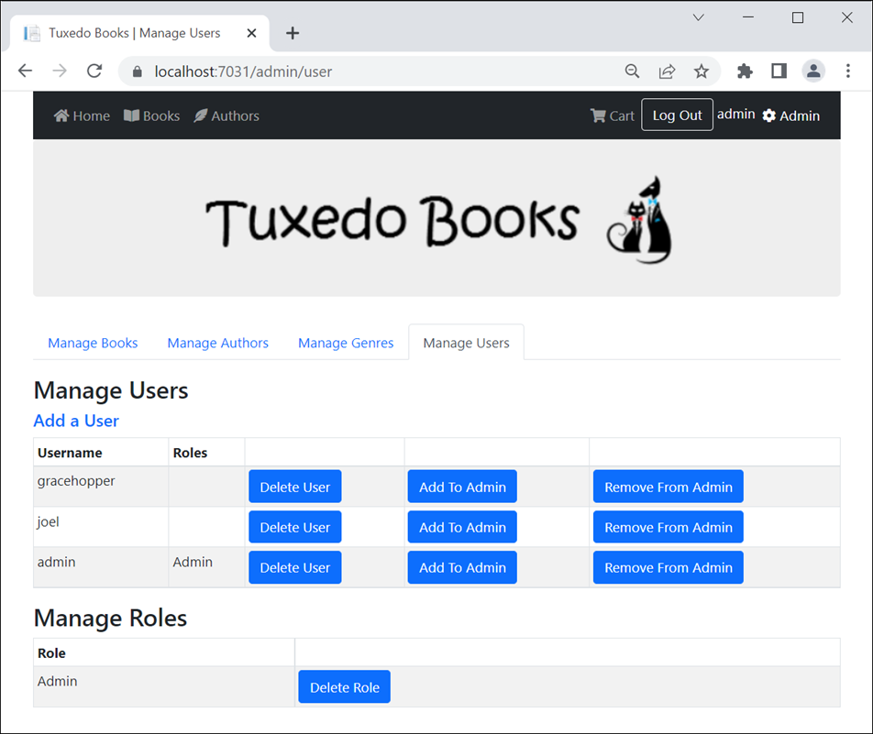
The Manage Users page

Slide 54
The updated User entity
using System.ComponentModel.DataAnnotations.Schema;
...
public class User : IdentityUser
{
[NotMapped]
public IList<string> RoleNames { get; set; } = null!;
}

Slide 55
The User view model
using Microsoft.AspNetCore.Identity;
...
public class UserViewModel
{
public IEnumerable<User> Users { get; set; } = null!;
public IEnumerable<IdentityRole> Roles { get; set; }
= null!;
}

Slide 56
The User controller and its Index() action method (part 1)
using Microsoft.AspNetCore.Mvc;
using Microsoft.AspNetCore.Authorization;
using Microsoft.AspNetCore.Identity;
using Bookstore.Models;
...
[Authorize(Role = "Admin")]
[Area("Admin")]
public class UserController : Controller
{
private UserManager<User> userManager;
private RoleManager<IdentityRole> roleManager;
public UserController(UserManager<User> userMngr,
RoleManager<IdentityRole> roleMngr)
{
userManager = userMngr;
roleManager = roleMngr;
}

Slide 57
The User controller and its Index() action method (part 2)
public async Task<IActionResult> Index()
{
List<User> users = new List<User>();
foreach (User user in userManager.Users)
{
user.RoleNames = await userManager.GetRolesAsync(user);
users.Add(user);
}
UserViewModel model = new UserViewModel
{
Users = users,
Roles = roleManager.Roles
};
return View(model);
}
// the other action methods
}

Slide 58
The User/Index view (part 1)
@model UserViewModel
@{
ViewData["Title"] = " | Manage Users";
}
<h1 class="mb-2">Manage Users</h1>
<h5 class="mt-2"><a asp-action="Add">Add a User</a></h5>
<table class="table table-bordered table-striped table-sm">
<thead>
<tr><th>Username</th><th>Roles</th>
<th></th><th></th><th></th>
</tr>
</thead>
<tbody>
@if (Model.Users.Count() == 0)
{
<tr><td colspan="5">There are no user accounts.</td></tr>
}

Slide 59
The User/Index view (part 2)
else
{
@foreach (User user in Model.Users)
{
<tr>
<td>@user.UserName</td>
<td>
@foreach (string roleName in user.RoleNames)
{
<div>@roleName</div>
}
</td>
<td>
<form method="post" asp-action="Delete"
asp-route-id="@user.Id">
<button type="submit" class="btn btn-primary">
Delete User</button>
</form>
</td>

Slide 60
The User/Index view (part 3)
<td>
<form method="post" asp-action="AddToAdmin"
asp-route-id="@user.Id">
<button type="submit" class="btn btn-primary">
Add To Admin</button>
</form>
</td>
<td>
<form method="post" asp-action="RemoveFromAdmin"
asp-route-id="@user.Id">
<button type="submit" class="btn btn-primary">
Remove From Admin</button>
</form>
</td>
</tr>
}
}
</tbody>
</table>

Slide 61
The User/Index view (part 4)
<h1 class="mb-2">Manage Roles</h1>
@if (Model.Roles.Count() == 0)
{
<form method="post" asp-action="CreateAdminRole">
<button type="submit" class="btn btn-primary">
Create Admin Role</button>
</form>
}
else
{
<table class="table table-bordered table-striped table-sm">
<thead>
<tr><th>Role</th><th></th></tr>
</thead>
<tbody>
@foreach (var role in Model.Roles)
{
<tr>
<td>@role.Name</td>

Slide 62
The User/Index view (part 5)
<td>
<form method="post" asp-action="DeleteRole"
asp-route-id="@role.Id">
<button type="submit"
class="btn btn-primary">
Delete Role</button>
</form>
</td>
</tr>
}
</tbody>
</table>
}

Slide 63
Other action methods of the User controller (part 1)
[HttpPost]
public async Task<IActionResult> Delete(string id)
{
User user = await userManager.FindByIdAsync(id);
if (user != null) {
IdentityResult result =
await userManager.DeleteAsync(user);
if (!result.Succeeded) { // if failed
string errorMessage = "";
foreach (IdentityError error in result.Errors) {
errorMessage += error.Description + " | ";
}
TempData["message"] = errorMessage;
}
}
return RedirectToAction("Index");
}
// the Add() methods work like the Register() methods

Slide 64
Other action methods (part 2)
[HttpPost]
public async Task<IActionResult> AddToAdmin(string id)
{
IdentityRole adminRole =
await roleManager.FindByNameAsync("Admin");
if (adminRole == null) {
TempData["message"] = "Admin role does not exist. "
+ "Click 'Create Admin Role' button to create it.";
}
else {
User user = await userManager.FindByIdAsync(id);
await userManager.AddToRoleAsync(user, adminRole.Name);
}
return RedirectToAction("Index");
}

Slide 65
Other action methods (part 3)
[HttpPost]
public async Task<IActionResult> RemoveFromAdmin(string id)
{
User user = await userManager.FindByIdAsync(id);
await userManager.RemoveFromRoleAsync(user, "Admin");
return RedirectToAction("Index");
}
[HttpPost]
public async Task<IActionResult> DeleteRole(string id)
{
IdentityRole role = await roleManager.FindByIdAsync(id);
await roleManager.DeleteAsync(role);
return RedirectToAction("Index");
}
[HttpPost]
public async Task<IActionResult> CreateAdminRole()
{
await roleManager.CreateAsync(new IdentityRole("Admin"));
return RedirectToAction("Index");
}

Slide 66
Using directive for the Authorization attributes
using Microsoft.AspNetCore.Authorization;
The Cart controller requires users to be logged in
[Authorize]
public class CartController : Controller {
...
}
Controllers in the Admin area require users to be in the Admin role
[Authorize(Roles = "Admin")]
[Area("Admin")]
public class BookController : Controller {
...
}

Slide 67
The AccessDenied() action method of the Account controller
public ViewResult AccessDenied()
{
return View();
}
The code for the Account/AccessDenied view
@{
ViewBag.Title = "Access Denied";
}
<h2>Access Denied</h2>

Slide 68
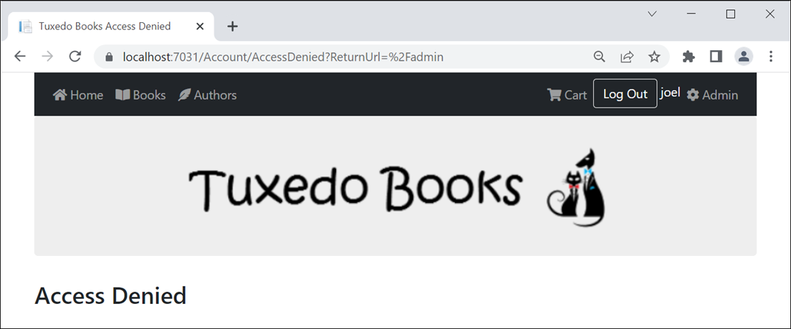
The Account/AccessDenied view

Slide 69
A static asynchronous method that seeds an Admin role and user (part 1)
using Microsoft.AspNetCore.Identity;
namespace Bookstore.Models
{
public class ConfigureIdentity
{
public static async Task CreateAdminUserAsync(
IServiceProvider provider)
{
var roleManager = provider
.GetRequiredService<RoleManager<IdentityRole>>();
var userManager =
provider.GetRequiredService<UserManager<User>>();
string username = "admin";
string password = "Sesame";
string roleName = "Admin";

Slide 70
A static asynchronous method that seeds an Admin role and user (part 2)
// if role doesn't exist, create it
if (await roleManager.FindByNameAsync(roleName) == null)
{
await roleManager.CreateAsync(
new IdentityRole(roleName));
}
// if username doesn't exist, create it and add to role
if (await userManager.FindByNameAsync(username) == null)
{
User user = new User { UserName = username };
var result = await userManager.CreateAsync(
user, password);
if (result.Succeeded)
{
await userManager.AddToRoleAsync(
user, roleName);
}
}
}
}
}

Slide 71
Code in the Program.cs file that calls the method
var app = builder.Build();
...
app.UseAuthentication();
app.UseAuthorization();
var scopeFactory = app.Services
.GetRequiredService<IServiceScopeFactory>();
using (var scope = scopeFactory.CreateScope())
{
await ConfigureIdentity.CreateAdminUserAsync(
scope.ServiceProvider);
}
...
app.Run();

Slide 72
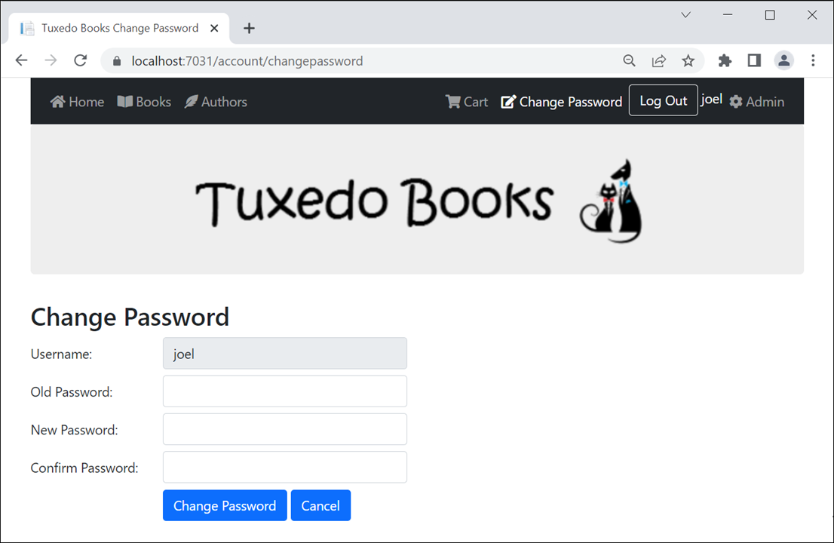
The Account/Change Password view

Slide 73
The ChangePassword view model
using System.ComponentModel.DataAnnotations;
namespace Bookstore.Models
{
public class ChangePasswordViewModel
{
public string Username { get; set; } = string.Empty;
[Required(ErrorMessage = "Please enter your password.")]
public string OldPassword { get; set; } = string.Empty;
[Required(ErrorMessage = "Please enter your new password.")]
[DataType(DataType.Password)]
[Compare("ConfirmPassword")]
public string NewPassword { get; set; } = string.Empty;
[Required(ErrorMessage =
"Please confirm your new password.")]
[DataType(DataType.Password)]
[Display(Name = "Confirm Password")]
public string ConfirmPassword { get; set; } = string.Empty;
}
}

Slide 74
The HTML for the Username field in the Account/ChangePassword view
<div class="row mb-2">
<label class="col-form-label col-md-2">
Username:</label>
<div class="col-md-4">
<input asp-for="Username" class="form-control"
readonly />
</div>
</div>

Slide 75
The ChangePassword() action method for GET requests
[HttpGet]
public IActionResult ChangePassword()
{
var model = new ChangePasswordViewModel {
Username = User.Identity?.Name ?? ""
};
return View(model);
}

Slide 76
The ChangePassword() action method for POST requests
[HttpPost]
public async Task<IActionResult> ChangePassword(
ChangePasswordViewModel model)
{
if (ModelState.IsValid) {
User user = await userManager.FindByNameAsync(
model.Username);
var result = await userManager.ChangePasswordAsync(user,
model.OldPassword, model.NewPassword);
if (result.Succeeded) {
TempData["message"] = "Password changed successfully";
return RedirectToAction("Index" , "Home");
}
else {
foreach (IdentityError error in result.Errors) {
ModelState.AddModelError("", error.Description);
}
}
}
return View(model);
}

Slide 77
The updated User class
public class User : IdentityUser
{
// need to be added to DB
public string FirstName { get; set; } = string.Empty;
public string LastName { get; set; } = string.Empty;
[NotMapped]
public IList<string> RoleNames { get; set; };
}

Slide 78
The updated Register view model (part 1)
public class RegisterViewModel
{
[Required(ErrorMessage = "Please enter a username.")]
[StringLength(255)]
public string Username { get; set; } = string.Empty;
[Required(ErrorMessage = "Please enter a first name.")]
[StringLength(255)]
public string Firstname { get; set; } = string.Empty;
[Required(ErrorMessage = "Please enter a last name.")]
[StringLength(255)]
public string Lastname { get; set; } = string.Empty;
// from IdentityUser class
[Required(ErrorMessage = "Please enter an email address.")]
[DataType(DataType.EmailAddress)]
public string Email { get; set; } = string.Empty;

Slide 79
The updated Register view model (part 2)
[Required(ErrorMessage = "Please enter a password.")]
[DataType(DataType.Password)]
[Compare("ConfirmPassword")]
public string Password { get; set; } = string.Empty;
[Required(ErrorMessage = "Please confirm your password.")]
[DataType(DataType.Password)]
[Display(Name = "Confirm Password")]
public string ConfirmPassword { get; set; } = string.Empty;
}

